Slide 1
What does it take to get in the MLB Hall of Fame?
By Hayden Lamprecht

Slide 2
What is WAR?
WAR (Wins above Replacement) is a key metric in measuring a baseball player’s value to their team.
It estimates how many more games a player helped their team win compared to a replacement level player.
WAR is split up into pitching WAR and batting WAR and utilizes all major stats to calculate it.
Using Total WAR and Years played
Data was acquired from Baseball-Reference.com and the Lahman database

Slide 3
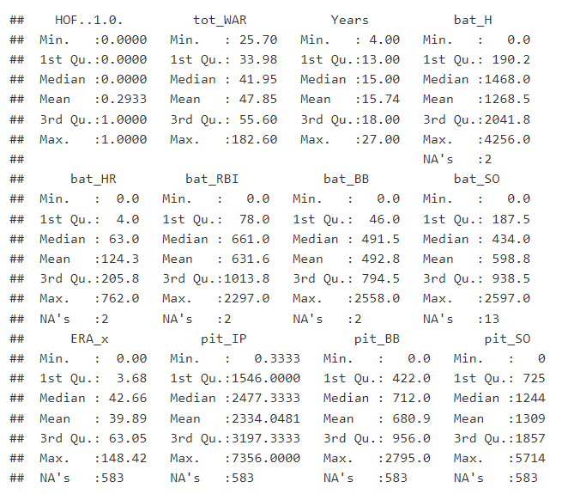
Data
Data collected:
992 observations of 87 variables
Hits, Homeruns, RBIs, Walks, Strikeouts
ERA, Innings Pitched, etc.

Slide 4
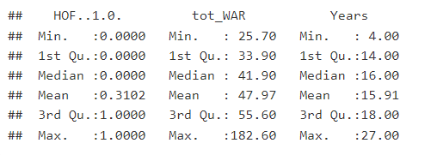
Data
Filtered dataset to only include retired players
Mainly focus on total WAR and Years played

Slide 5
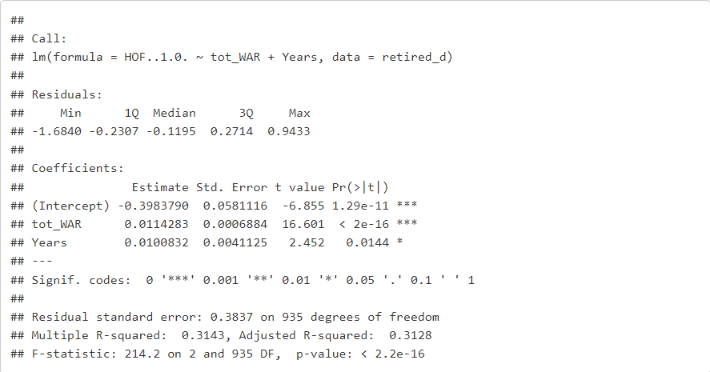
Previous model
Why does linear not work?
HOF is a dummy variable (1/0)
Assumes constant effect across all positions

Slide 6
Solutions
Probit/Logit
Assumes the same WAR effect
Fixed effects
Would not affect the slopes
Separate positional regressions
Too noisy
Random Coefficients
Random coefficients shows the WAR effect varied by position
Partially pools information across groups
Implements shrinkage

Slide 7
Assumptions
Players differ in how WAR matters
WAR distribution is structured
A questionable assumption:
Random coefficients are independent of regressors
Random coefficients are still a step up from a linear model

Slide 8
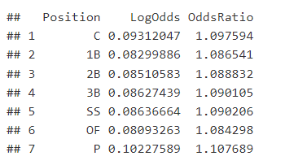
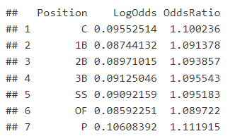
Findings
With Years Without Years

Slide 9
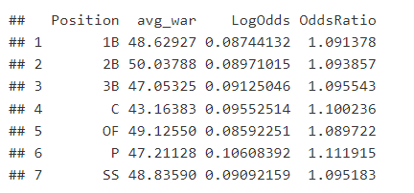
Findings

Slide 10
Critical thoughts
WAR does not vary as much as expected
WAR possibly already counts for positional adjustments
Definite omitted variable bias: awards, championships, era played
More correlation than causation
Fixed effects, logit, or interaction models
Locating better variables

